Slide 1
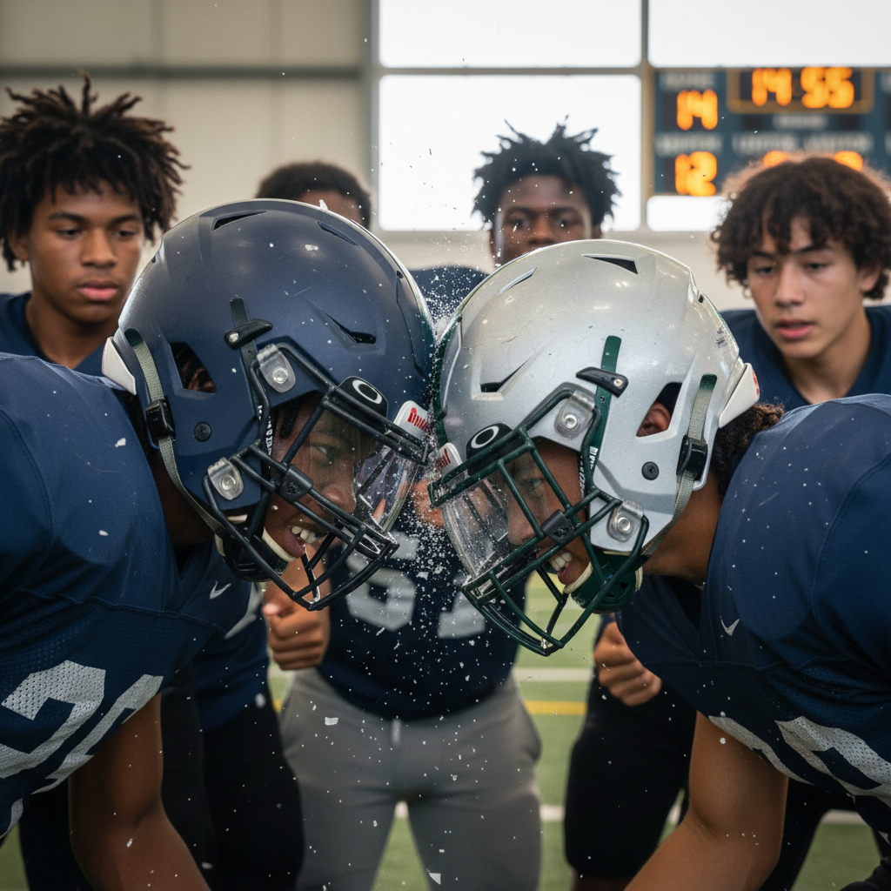
ModelIt!
Student Lesson
The Concussion Problem
Why Helmets Can't Stop Your Brain from Slamming Into Your Skull
NGSS: MS-PS2-1, MS-PS2-2
8th Grade
1/9

Slide 2
What You Will Learn Today
Learning Goals
* Apply Newton's Laws of Motion to explain what happens during a collision
* Model how force, mass, and acceleration are related in impact scenarios
* Predict how changing collision speed or mass affects the force of impact
* Evaluate helmet designs based on force reduction principles
Key Vocabulary
Newton's Third Law
For every action force, there is an equal and opposite reaction force
Impulse
The change in momentum — equals force multiplied by time of contact
Concussion
A brain injury caused by the brain hitting the inside of the skull during sudden deceleration
Deceleration
Negative acceleration — the rate at which an object slows down
2/9

Slide 3
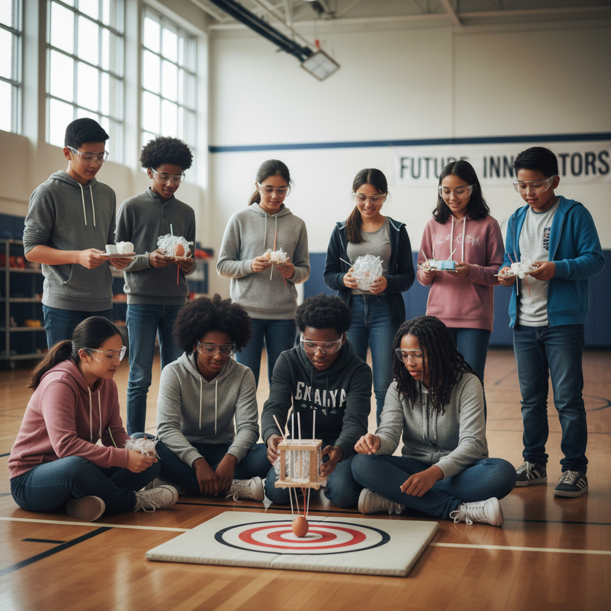
The Big Question
Why do football players still get concussions even while wearing helmets?
Why Helmets Can't Stop Your Brain from Slamming Into Your Skull. Today we'll build a MODEL to discover the answer!
3/9

Slide 4
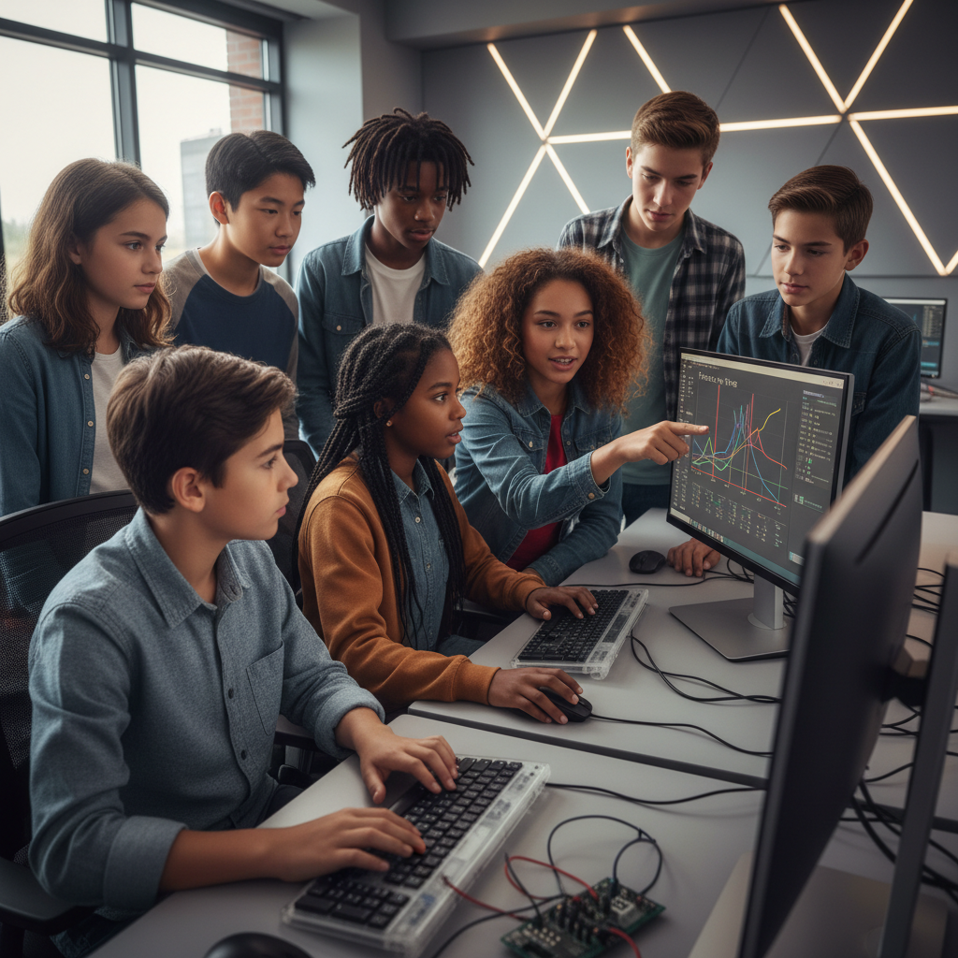
Today We Will Build a Model!
A model helps us understand complex systems!
1. LOCATE
Identify the COMPONENTS (parts) of the system
2. ESTABLISH
Connect them with RELATIONSHIPS (+ or -)
3. VISUALIZE
Build your model in ModelIt!
4. EVALUATE
Run SIMULATIONS to test scenarios
5. REVISE
Improve your model based on evidence
4/9

Slide 5
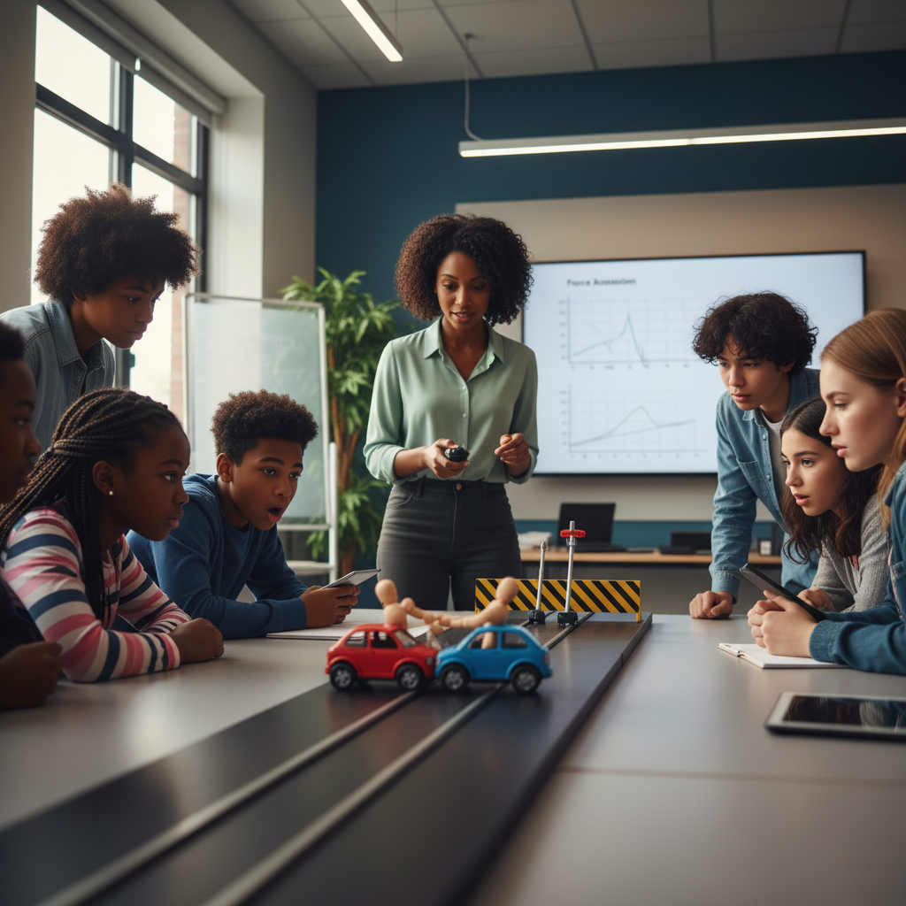
Activity 1: Sort the Components
Sort these components into EXTERNAL (inputs from outside) and INTERNAL (inside the system):
Your Components:
* Collision Speed
* Player Mass
* Impact Force
* Brain Acceleration
Think: Which components can we control? Which happen on their own?
5/9

Slide 6
Activity 2: Connect with Arrows
Draw arrows to show HOW components affect each other:
(+) POSITIVE Relationship
When one goes UP, the other goes UP too
(-) NEGATIVE Relationship
When one goes UP, the other goes DOWN
Think About It:
When collision speed increases, what do you think happens to the force experienced by the brain inside the helmet?
6/9

Slide 7
Activity 3: Run the Simulation!
Test these scenarios in ModelIt!
Jogging Speed Collision
Set Collision Speed to 5 mph with normal Player Mass
Full Sprint Collision
Lock Collision Speed to 20 mph and observe the impact force
Helmet Comparison
Add a 'padding thickness' factor and compare thin vs. thick padding
Watch the activity graphs change!
[ModelIt Platform Screenshot - Simulation Results Graph]
7/9

Slide 8
What Did We Discover?
Our Model Showed Us:
* Force increases dramatically with speed — doubling speed more than doubles the force
* Helmets reduce force by EXTENDING the time of impact (impulse), not by blocking it
* The brain floats in fluid inside the skull — it keeps moving when the skull stops
* No helmet can eliminate concussion risk because the brain will always decelerate during impact
Answer: During a collision, the skull stops suddenly but the brain keeps moving (Newton's First Law), slamming into the skull. Helmets extend the collision time to reduce force, but can't prevent the brain from decelerating inside the skull!
8/9

Slide 9
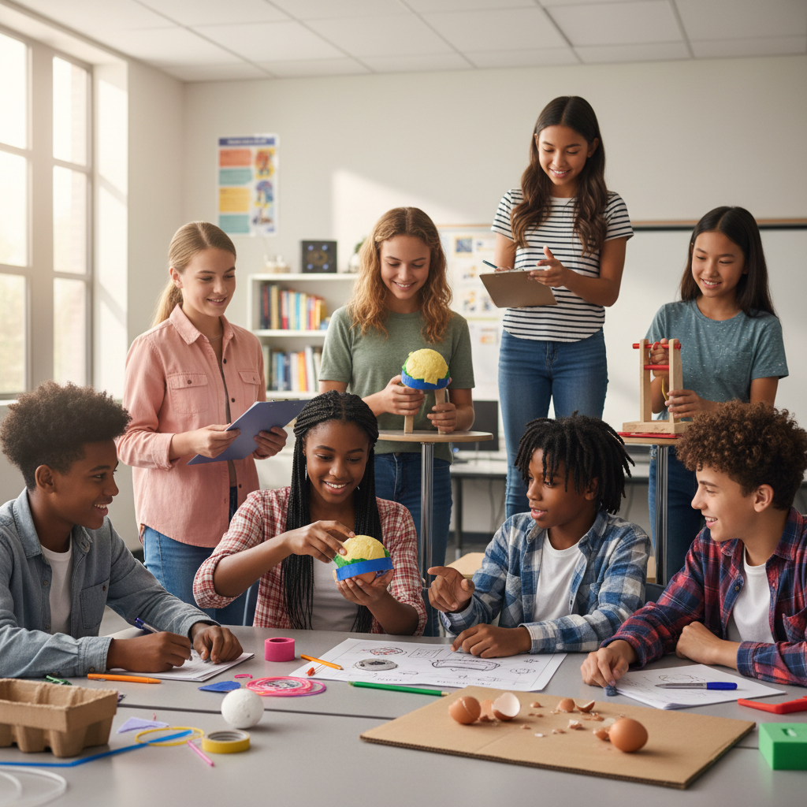
STEM Challenge: Design a Better Helmet
YOUR ENGINEERING MISSION
Design a helmet that minimizes brain acceleration during impacts using the principles from your model.
The Challenge:
A sports equipment company has hired your team to improve their football helmet design. You must use physics principles to explain why your design reduces concussion risk.
Think Like an Engineer:
* What physical principle makes current helmets work?
* How could you increase the time of impact to reduce force?
* What materials absorb energy best?
REAL CAREER CONNECTION: Biomedical Engineers design safety equipment using physics and biology. Sports Biomechanists study forces on the human body during athletics. They earn $70,000-$120,000/year. The skills you're using TODAY are the same ones they use on the job!
9/9

